Slide 1
Google Data Analysis Course Case Study Case Study 1: How Does a Bike-Share Navigate Speedy Success?
Presented By: Aliyu Atiku Mustapha
Last Updated: 27/07/2022

Slide 2
Design marketing strategies aimed at converting casual riders into annual members.
Objective

Slide 3
1. How do annual members and casual riders use Cyclistic bikes differently? 2. Why would casual riders buy Cyclistic annual memberships? 3. How can Cyclistic use digital media to influence casual riders to become members?
Task

Slide 4
Source: Data was sourced directly from company and was deemed reliable. Data Range Period: June 2021 to May 2022 Note: Data was cleaned, structured and organized in the best possible way.
Source of data and type

Slide 5
1. Understand Casual and Member usage. 2. Bike Usage during the week. 3. Most preferred Bike type. 4. Average, min and max length of trips. 5. Busy stations for starting and ending trips. 6. Trips comparison per Month.
analysis

Slide 6
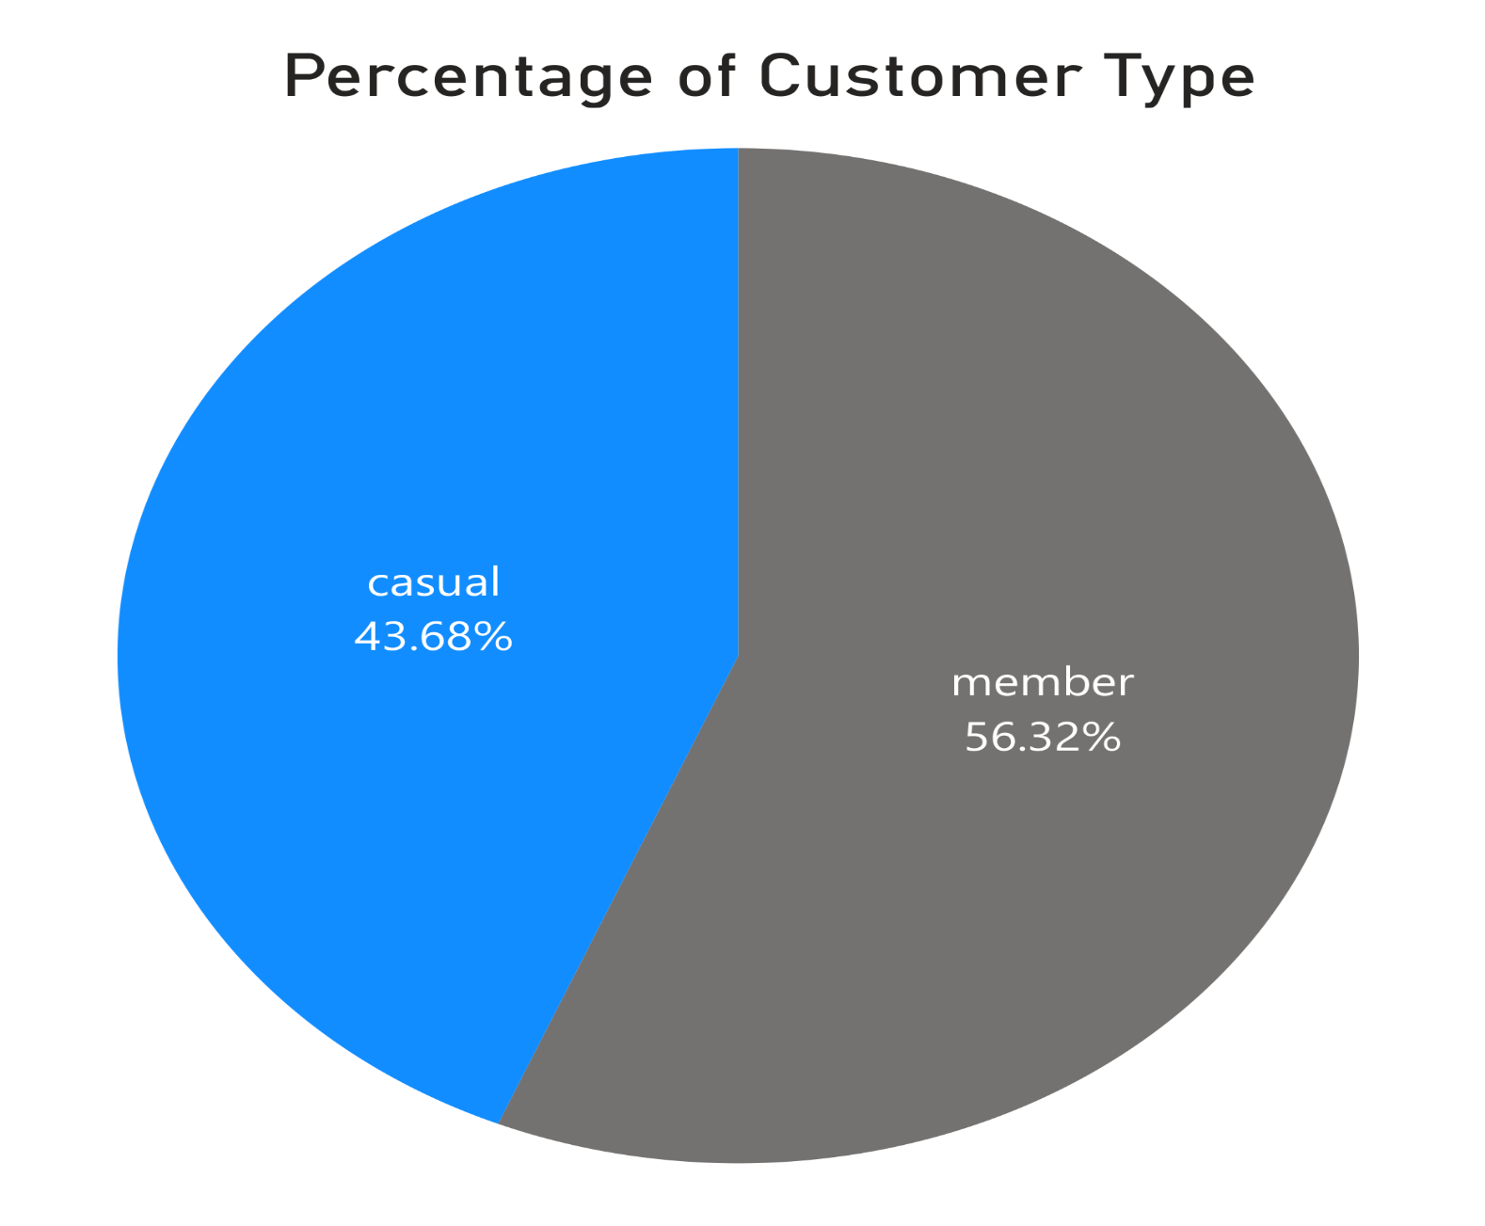
Customer type

Slide 7
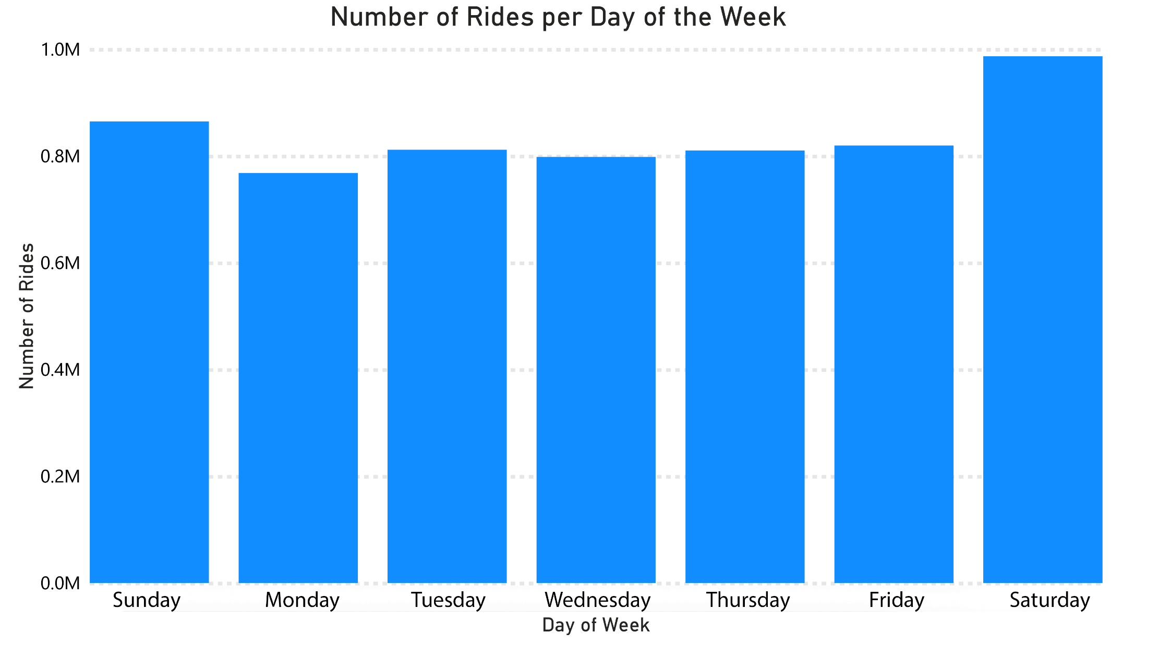
Daily usage numbers

Slide 8
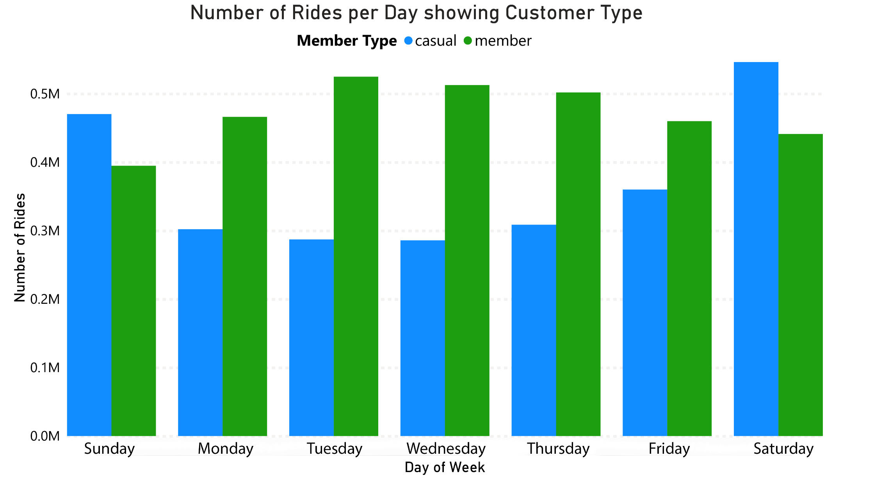
Daily usage per customer type

Slide 9
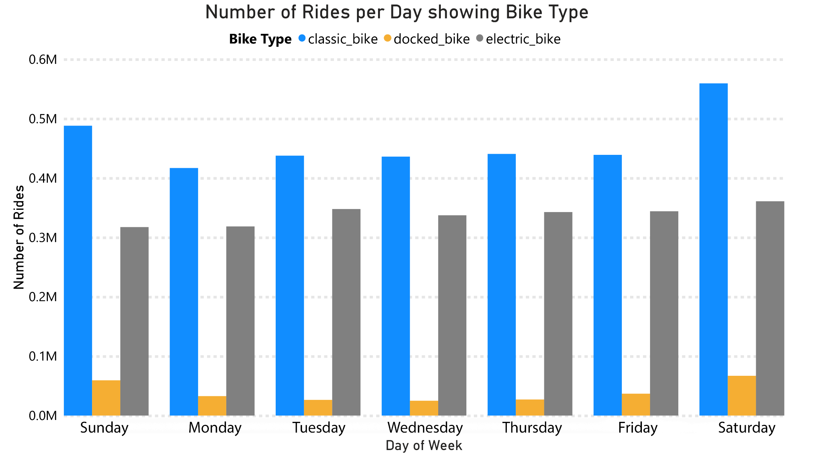
Daily usage per Bike type

Slide 10
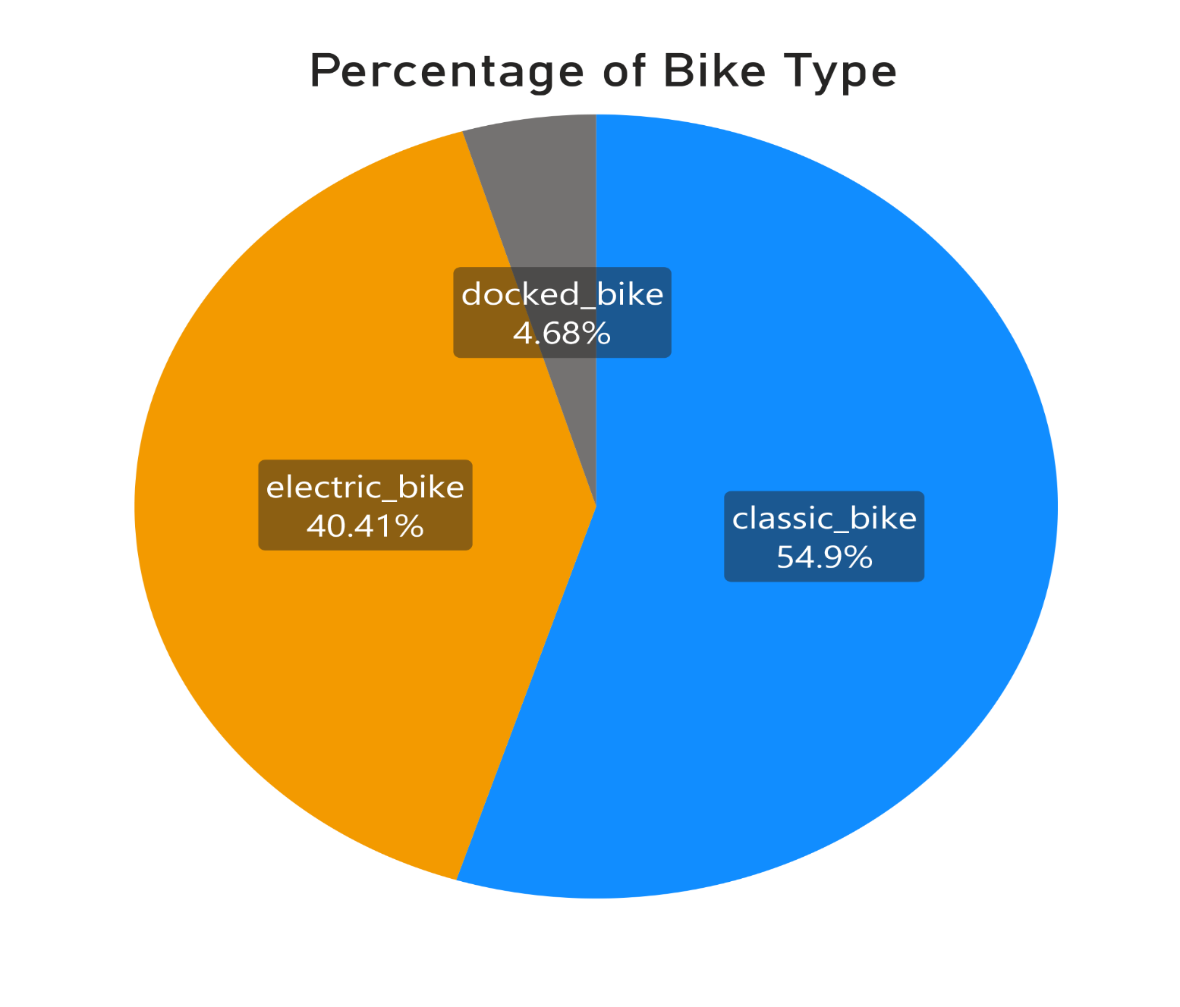
Bike Type Preference

Slide 11
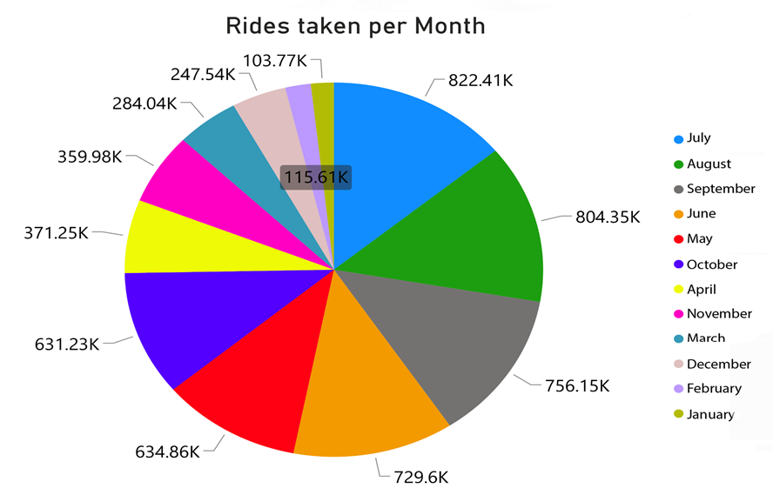
Trips per month

Slide 12
1. There are 12.64% more Member Riders that use Cyclistics Bike- Share than Casual riders. Which drives the need for more. 2. Casual Riders use bikes majorly during weekends while Members use during weekdays, which indicates usage is work related. 3. Casual and Members prefer the Classic and Electric bikes over the Docked. 4. Some Stations have much higher numbers of rides starting and ending, with some having low-ten figures. 5. Summer Months take the larger share of rides taken per year.
Take Away

Slide 13
1. Run specific online social-media campaigns targeting casual users. 2. Campaigns should have higher visibility during weekends, which is when the target audience mostly use the service. 3. Classic and Electric bikes should be increased. 4. Stations with higher ride starting and ending figures should also run adverts and campaigns. 5. Sunny months of the year have higher ride numbers and so campaigns should run more often in them.
Recommendations

Slide 14
1. Need more clarity in data to understand anomalies a. What trip lengths of 0 minute mean? b. Why Start or End station names were missing? c. Inconsistency in station IDs . 2. Data over multiple years will provide more season trends and patterns. 3. More user specific data to understand what influences bike usage? 4. Surveys should be taken to understand which social media platforms most bike riders use to have a more tailored and target campaigns.
Next Steps

Slide 15
THANK YOU!

